Slide 1
J-Zephyr Sebastian D. Eastham
Website: LAE.MIT.EDU
Twitter: @MIT_LAE

Slide 2
Project aim
Modeling
INCREASING SPEED
FORTRAN: Fast
Somewhat hostile
Analysis
Julia…?
MATLAB: Slow, accessible
Well suited to analysis

Slide 3
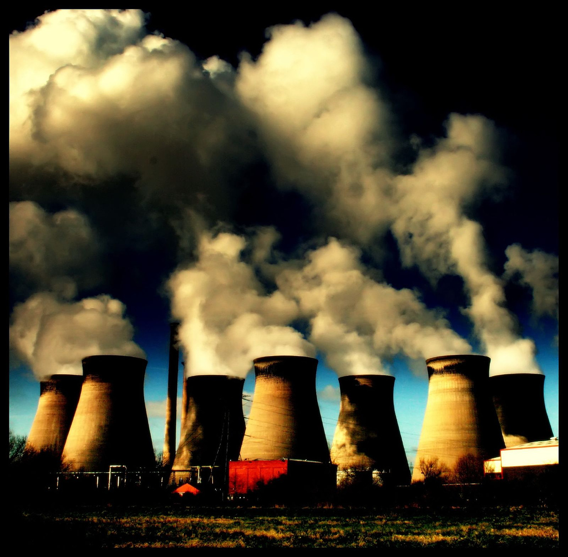
Base model: GEOS-Chem
Chemistry Transport Model (CTM)
Simulates atmosphere using combination of CFD with chemistry solver

Slide 4
New model: J-Zephyr
Feature | GEOS-Chem | J-Zephyr
Language | FORTRAN 77/90 | Julia v0.3.0
Chemistry? | Yes | No
Transport? | 3-D | 2-D*
PBL mixing? | Yes | WIP*
Convection? | Yes | WIP*
Parallelization | OpenMP | DArrays
Maximum CPUs | Physical cores | Physical cores
Maximum mahcines | 1 | Network size*
Dev time? | 10 years | 3 months

Slide 5
Parallelization: OpenMP v MPI
HEAD
GEOS-Chem
HEAD
Time
WORKER
WORKER
WORKER
Loops independently parallel
Arrays redistributed each time
WORKER
WORKER
WORKER
J-Zephyr
WORKER
WORKER
WORKER
Data stored in DArrays
Low worker communication
WORKER
WORKER
WORKER
Notes:
Both GC and JZ, head proc coordinates [click]
GC uses OpenMP
Each loop is broken out [click] requiring data to be redistributed
In JZ, use Darrays [click]
Data is stored in subgrids between loops [click], reducing communication

Slide 6
Conflict of interest
Chemistry and transport processes favor different domain decompositions
SPECIES
Transport operates independently on each species, mostly horizontal
Requires halo data
Ideal decomposition: parallel by species
SPATIAL
Notes:
EXPLAIN GRID!

Slide 7
Conflict of interest
Chemistry and transport processes favor different domain decompositions
SPECIES
Chemistry concerned only with small spatial domain
Often concerned with columnar processes and many species at once
Ideal decomposition: parallel by longitude/latitude
J-Zephyr uses this
SPATIAL

Slide 8
Model structure
Read input file
Set up DArrays
Begin simulation
Read in GEOS-5 data
Notes:
Customized input file establishes simulation parameters
Basic grid parameters are set up, and various constants and multipliers are calculated in advance on the head node
GEOS-5 meteorological data including surface pressures, wind velocities, moisture etc are read in from FORTRAN “binary punch card” files and stored in Darrays. These will need to be updated every 3-6 simulation hours
A set of nested loops, optimized with respect to handling the met data transfers

Slide 9
Input
Input file allows specification of:
Date range (2004-2011)
Machine file
Output directory
Time step length
Tracers (unlimited number)

Slide 10
DArrays
Grid distribution automatically determined on a 2-D (surface pressure) array in initialization
All subsequent DArrays use this grid as their basis
All cores have access to:
Restricted latitudes
Restricted longitudes
All pressure levels
All tracers

Slide 11
Modules
Initially intended to use “common-block” approach, holding DArrays as module variables
This caused a huge number of problems
Now pass large data structures (e.g. meteorological state variable holds 74 72x46x72 DArrays) between functions

Slide 12
Project status
Implemented so far:
Model initialization
Single machine parallelization
Read-in of meteorological data from FORTRAN formatted records (BPCH)
Derivation of 3-D pressure fluxes from meteorological data
Simple emissions scheme
Horizontal advection and mixing

Slide 13
Lessons
Excellent learning experience in parallel
Inter-worker communication prohibitively slow
Parallel debugging much slower than serial!
5000+ lines of code do not guarantee results

Slide 14
Conclusions
Project intended to give insight into difficulties that crop up when solving large problems in parallel fashion
Highlighted disproportionate penalties associated with communication
Demonstrated importance of intelligent domain decomposition
Showcased Julia capabilities – extremely rough first pass still capable of emulating CTM on simple 6-core machine

Slide 15
Next steps
Current domain decomposition is far from ideal
Priority 1: Optimize “halo exchange”
Cell [I,J] here requires data from 3 other workers
Problem worsens at poles
Should assign polar caps to single workers
 |  | J+2
 |  | J+1
I-2 | I-1 | I,J | I+1 | I+2
 |  | J-1
 |  | J-2

Slide 16
Future work
Add vertical transport
Routines in place but not yet tested
Verify horizontal and vertical transport against GEOS-Chem
Perform timing analysis
Excessive inter-worker communication
Add deep convection
Add PBL mixing

Slide 17
Laboratory for Aviation and the Environment Massachusetts Institute of Technology
Presenter Name seastham@mit.edu Website: LAE.MIT.EDU
Twitter: @MIT_LAE

